Slide 1

By GAURAV KUMAR
Business Analyst Career Program - Capstone Project

Slide 2

Agenda
Data Exploration
Statistical Analysis using Excel
Graphical Analysis using Excel
Insert the given data into the SQL server
Import the Data from the SQL Database into PowerBI
Interactive Dashboard by using visualization tools
Conclusion and Inferences
Endnotes

Slide 3
Data Exploration
The given dataset infers a wide range of valuable information about a business's financial performance and operations. It contains the data of products sold during the period September 2013 to December 2014. It also includes the details like how many units sold, what’s the manufacturing price & sale price of the product, how much discount offered, profit earned etc.
This dataset has categorical values like segment, country, product, discount band, date, and month name which are also known as dimensions of the dataset, and numerical values like units sold, manufacturing price, sale price, gross sales, discounts, sales, cost of goods sold (COGS), profit, and month number which are also called measures.
These dimensions and measures provide a comprehensive overview of the financial data set, allowing for analysis and insights into sales, profitability, and performance Like Revenue analysis (total revenue, revenue trends), Profit Analysis, Cost analysis, Discount analysis, etc across different segments, countries, products, and time periods. This structured data can be used for various financial and business analytics purposes, including performance evaluation, strategy formulation, and decision-making.
A brief description of the dimensions & measures are listed in succeeding slides.

Slide 4
Data Exploration
Dimensions:-
Segment: This dimension categorizes data into different segments, which represent customer segments like Channel Partners, Enterprise, Government, Midmarket, and Small Business.
Country: The country dimension represents the geographical location where the financial transactions or sales occurred. It has the western countries like Canada, France, Germany, Mexico, and United States of America.
Product: This dimension categorizes products or product categories, providing insight into what was sold. It includes the products like Amarilla, Carretera, Montana, Paseo, Velo, and VTT.
Discount Band: This dimension categorizes data based on the discount band applied to sales transactions, which is divided into None, Low, Medium, and High.
Date: The date dimension represents the specific date of each financial transaction. The range spans from September 2013 to December 2014, which includes the first day of each month.
Month Name: This dimension represents the name of the month corresponding to each transaction date.

Slide 5
Data Exploration
Measures:-
Units Sold: This measure represents the quantity of products sold in each transaction.
Manufacturing Price: The manufacturing price is the cost at which the product was produced or acquired.
Sale Price: This measure represents the price at which the product was sold.
Gross Sales: Gross sales are the total revenue generated from the sales transactions before any deductions.
Discounts: Discounts represent the amount deducted from the gross sales due to discounts applied to transactions.
Sales: Sales represent the net sales revenue after accounting for discounts.
COGS (Cost of Goods Sold): COGS is the direct cost associated with producing the goods that were sold.
Profit: Profit is the difference between sales revenue and the cost of goods sold, providing insight into the profitability of the transactions.
Month Number: This measure represents the numerical month corresponding to each transaction date, often used for time-series analysis.
Year: This measure represents the year corresponding to each transaction date, often used for time-series analysis.

Slide 6
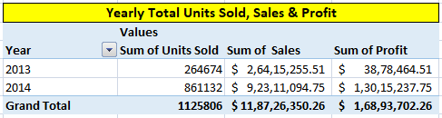
Statistical Analysis using Excel
Total Units Sold | 11,25,806.00
Average Units Sold | 1,608.29
Total Sales | $ 11,87,26,350.26
Average Sales | $ 1,69,609.07
Total COGS | $ 10,18,32,648.00
Average COGS | $ 1,45,475.21
Total Profit | $ 1,68,93,702.26
Average Profit | $ 24,133.86
Few Pivot table like ‘Country wise & Segment wise total Sales & profit’, ‘Yearly total Units sold, Sales & Profit’ etc. have been created to analyze the given dataset and find some insights related to it.
Some statistical value like product wise average sales & average profit, maximum & minimum discount offered & manufacturing price have been indicated.
Some facts from these analysis are listed below:-
Maximum Profit product-wise is $ 47,97,437.95 for “Paseo”.
Maximum & minimum discount offered is $ 1,49,677.50 & 0 respectively.
Maximum sales & profit are for Segment ‘Govenrment’.
France is the country which makes the maximum percentage of total profit followed by Germany.

Slide 7
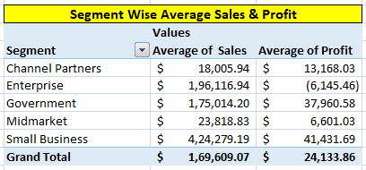
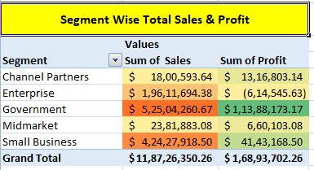
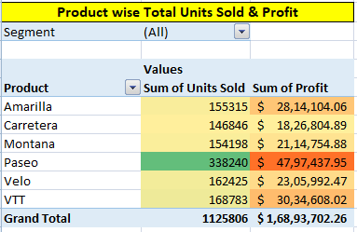
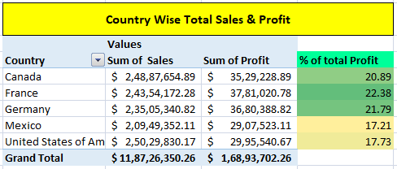
Statistical Analysis using Excel

Slide 8
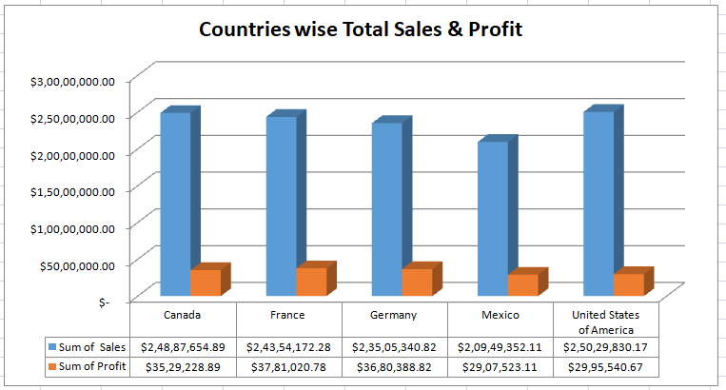
Graphical Analysis using Excel
Country-wise ‘Total Sales and Profit’ are represented using a column chart.
From the analysis, it can be seen that United States of America has the highest sales where as Mexico has the minimum sales.
Similarly, France has the highest profit whereas Mexico has minimum profit.

Slide 9
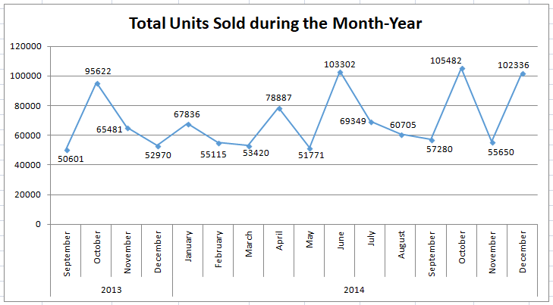
Graphical Analysis using Excel
Using a line chart, total units Sold during the Month of a particular year is represented here.
From the analysis, it can be seen that in 2013, maximum units sold in the month of October whereas minimum Units sold in month of September.
Similarly, in 2014, maximum units sold in the month of October whereas minimum Units sold in month of May.
During this period, the maximum units sold is ‘1,05,482’ Which belongs to October 2014 whereas minimum units sold is ‘50,601’ which belongs to September 2013.

Slide 10
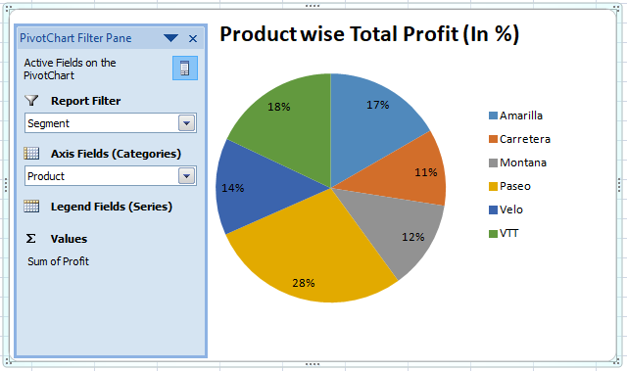
Graphical Analysis using Excel
Here, Product-wise total profit is represented using a Pie Chart.
From the analysis, it can be seen that Product ‘Paseo’ has the largest contribution of about 28% in total profit, whereas “Carretera” has the lowest contribution of about 11%.
A filter of Segment is added in the analysis, which may be used to visualize the Segment-wise profit contribution of a product.

Slide 11
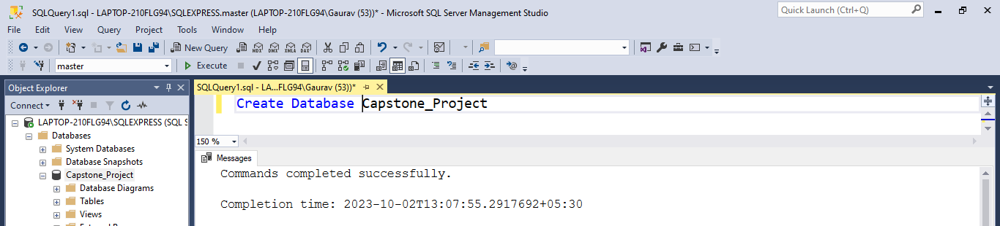
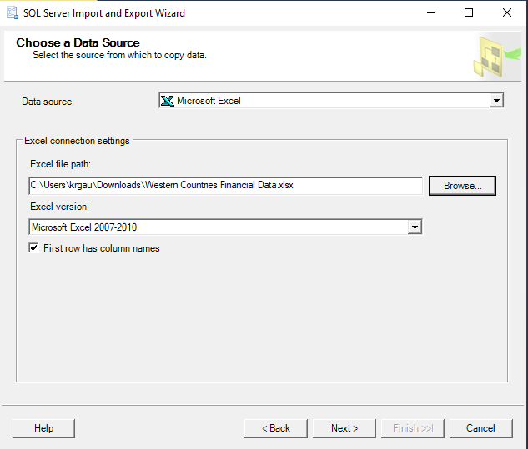
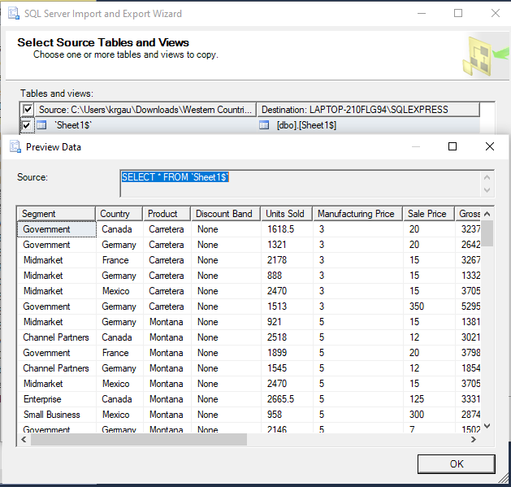
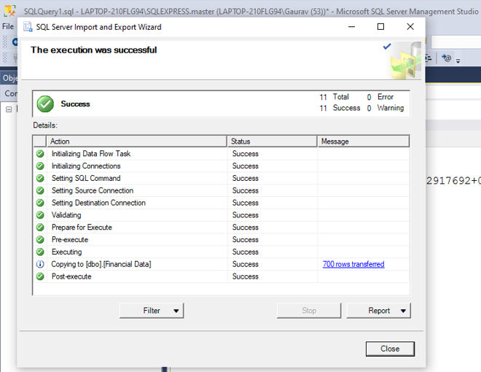
Insertion of the Given Data into the SQL server
Some relevant screenshots of the data insertion into a SQL DB and their successful execution
1. Database Creation
2. Choose the Source File
3. Preview Data
4. Successful Execution
Notes:
Steps performed to Insert the given data into the SQL Server is as follows:-
A database “Capstone_Project” created using SQL Query Create Database Capstone_Project where the given data is to be stored.
Right Click on “Capstone_Project” database by expending the ‘Databases’ option. Then Go to ‘Task’ and click “Import Data” to import the given excel file.
A dialogue box to choose a data source open where Select data source as Microsoft Excel.
Browse the Excel file “Western Countries Financial Data” and then click Next.
In next dialogue box, Select Destination as ‘Microsoft OLE DB Provider for SQL Server’. Check the Server name, Authentication and Database and Select accordingly. Then click next.
Select the available option as needed. Here “Copy data from one or more tables or views” is selected. Then Click next.
Here you have the option to select source tables and views. You may check & define the data type/parameters by click on ‘Edit Mappings’. You may also Preview the data. Then Click next to Save and Run Package. Click next and then click Finish.
After successful execution, Success message may be seen. You may find the table/views available in the excel file under the Table option available in ‘Capastone_Project’ Database.

Slide 12
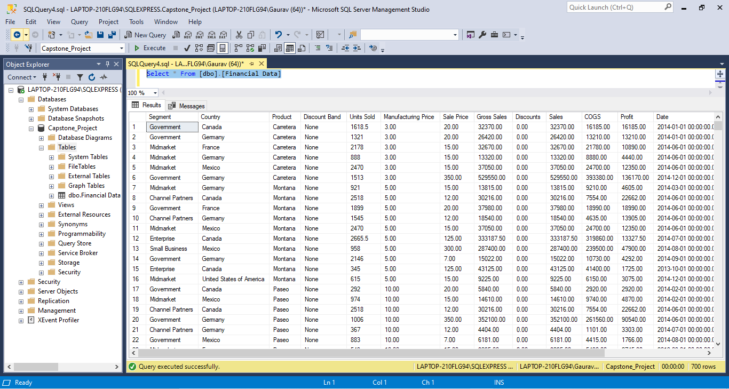
SQL Queries on the Imported Data into the SQL Server
Few Queries have been executed to verify the data properly imported into SQL database, which have been described in succeeding slides:-
1. Select * From [dbo].[Financial Data] => Returns data from all columns of table ‘Financial Data’.

Slide 13
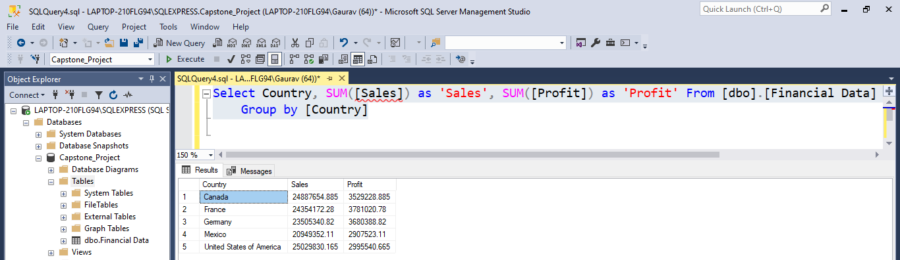
SQL Queries on the Imported Data into the SQL Server
2. Select Country, SUM([Sales]) as 'Sales', SUM([Profit]) as 'Profit' From [dbo].[Financial Data] Group by [Country] => Returns data for Country wise total Sales & Profit from Sales & Profit Column of table ‘Financial Data’.

Slide 14
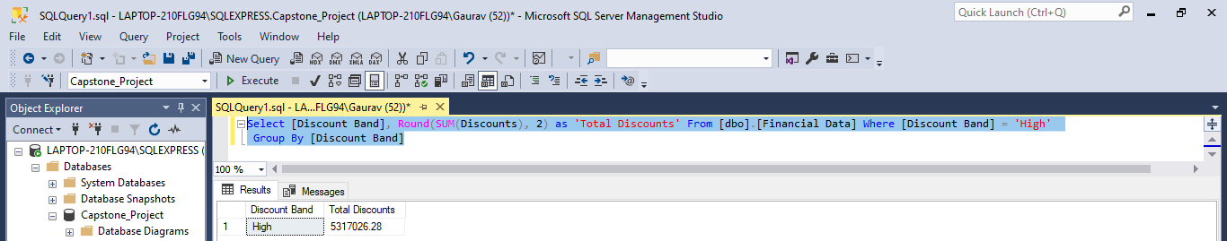
SQL Queries on the Imported Data into the SQL Server
3. Select [Discount Band], Round(SUM(Discounts), 2) as 'Total Discounts' From [dbo].[Financial Data] Where [Discount Band] = 'High‘ Group By [Discount Band] => Returns data for total Discounts (rounded off two decimal points) for Discount Band ‘High’ from Discounts Column of table ‘Financial Data’.

Slide 15
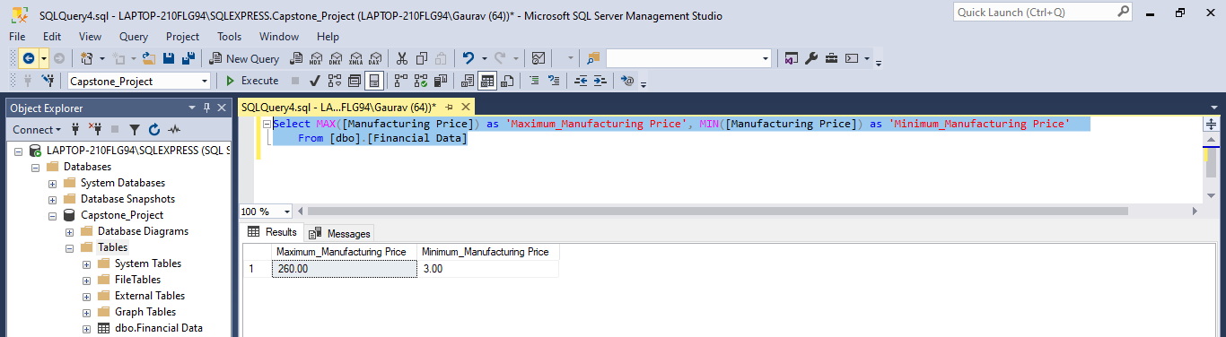
SQL Queries on the Imported Data into the SQL Server
4. Select MAX([Manufacturing Price]) as 'Maximum_Manufacturing Price', MIN([Manufacturing Price]) as 'Minimum_Manufacturing Price' From [dbo].[Financial Data] => Returns data for maximum & minimum manufacturing price from Discounts Column of table ‘Financial Data’.

Slide 16
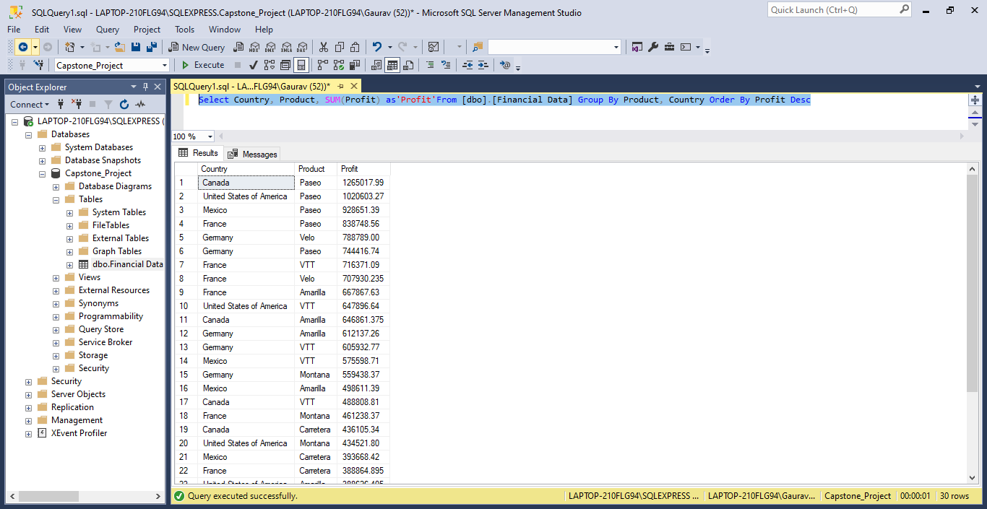
SQL Queries on the Imported Data into the SQL Server
5. Select Country, Product, SUM(Profit) as 'Profit’ From [dbo].[Financial Data] Group By Product, Country Order By Profit Desc => Returns data for total profit arranged in descending order & aggregated by country/product from Country, Product, Profit Column of table ‘Financial Data’.

Slide 17
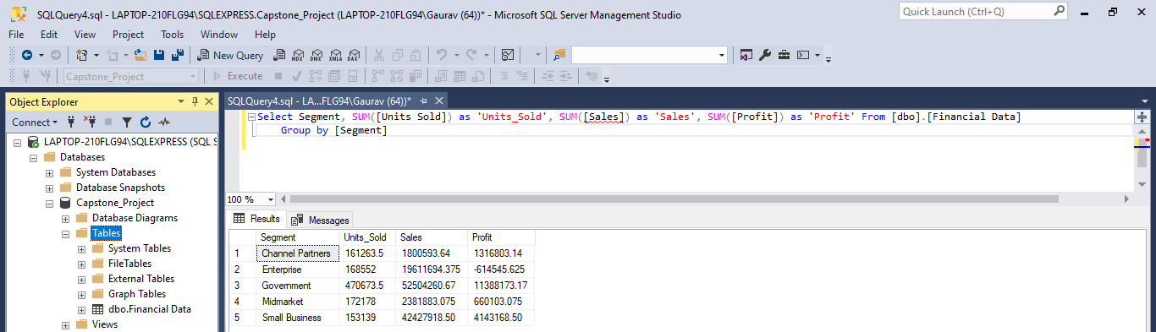
SQL Queries on the Imported Data into the SQL Server
6. Select Segment, SUM([Units Sold]) as 'Units_Sold', SUM([Sales]) as 'Sales', SUM([Profit]) as 'Profit‘ From [dbo].[Financial Data] Group by [Segment] => Returns data for total units sold, sales & profit aggregated by Segment from Segment, Units Sold, Sales, Profit Column of table ‘Financial Data’.

Slide 18
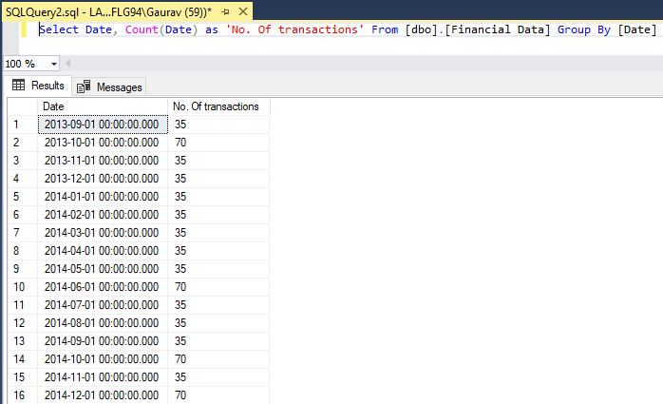
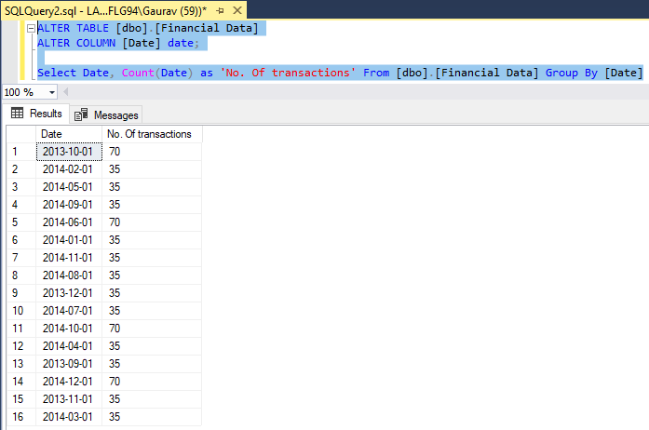
SQL Queries on the Imported Data into the SQL Server
7. ALTER TABLE [dbo].[Financial Data] ALTER COLUMN [Date] date; => Use to change the data type from datetime to date
Select Date, Count(Date) as 'No. Of transactions' From [dbo].[Financial Data] Group By [Date] => Returns data for total no. of transactions aggregated by Date from Date Column of table ‘Financial Data’.

Slide 19
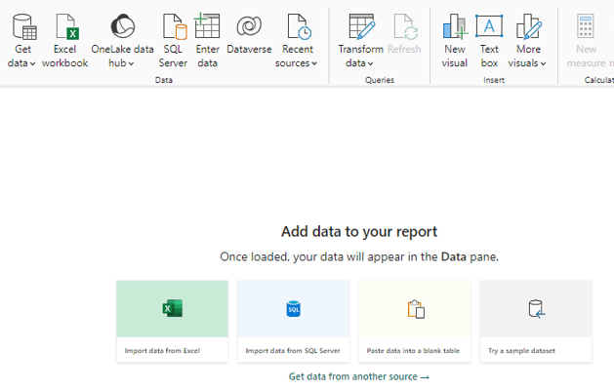
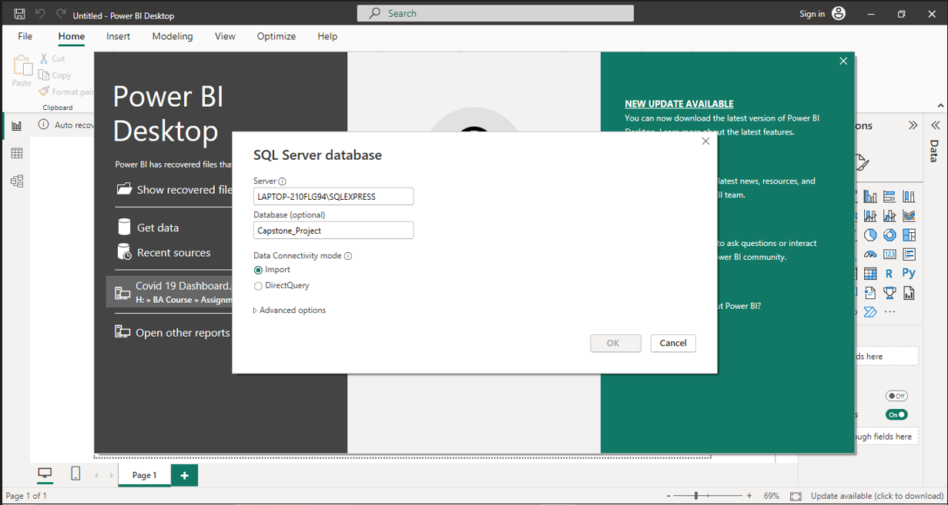
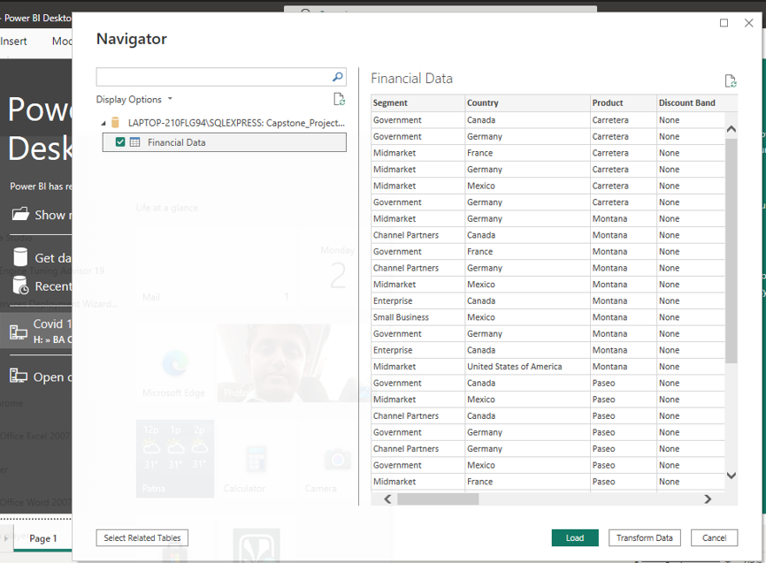
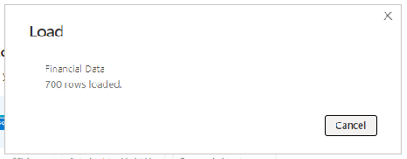
Import the Data from the SQL Database into PowerBI
Some relevant screenshots to import the data from SQL Server to Power BI and their successful Loading
Notes:
Steps performed to Import the data from the SQL database to Power BI is as follows:-
Click ‘Import data from SQL Server’ or ‘Get Data’ and then Select ‘SQL Server’.
Enter the details of server and Database (optional) from where the data is to be imported after opening of the ‘SQL Server database’ dialogue box. Then Opt for either ‘Import’ or ‘Direct Query’ as required under Data Connectivity mode and then click Ok and then connect.
Dialogue box ‘Navigator’ is opened. Here, select the required table from the selected database to further load the data into PowerBI.
Preview of Data is available here. Click ‘Load’ to import the data (if data transformation is needed then click on ‘Transform Data’ otherwise click load to proceed ahead).
After successful loading of data, a pop up will be there that …rows loaded with a green tick.

Slide 20
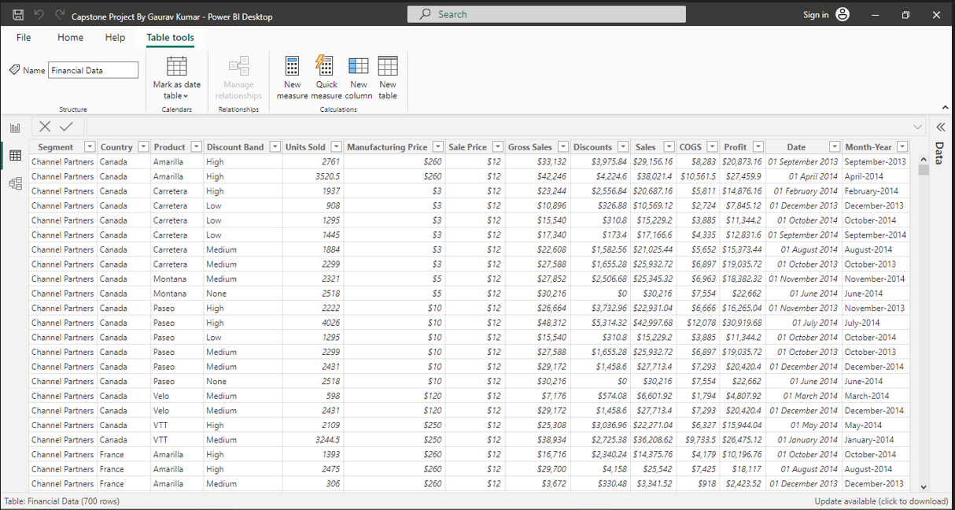
Import the Data from the SQL Database into PowerBI
View of Data in Power BI:-

Slide 21
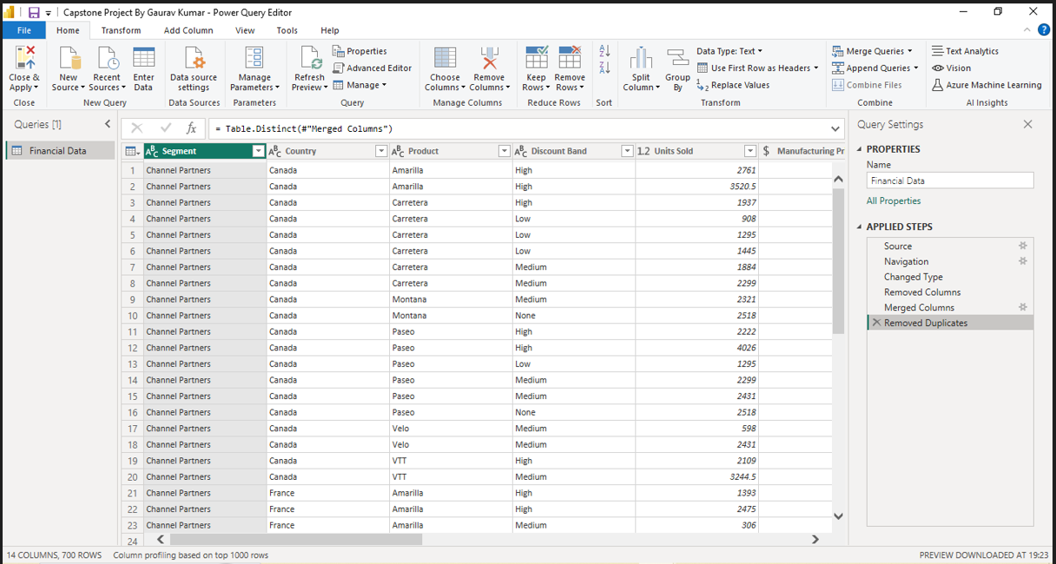
Import the Data from the SQL Database into PowerBI
Data cleaning or creation of measured for data analysis :-
Checked for any duplicates
Merged Column Month & Year to Month-Year
Remove the Column Month Number
Changed the data type

Slide 22
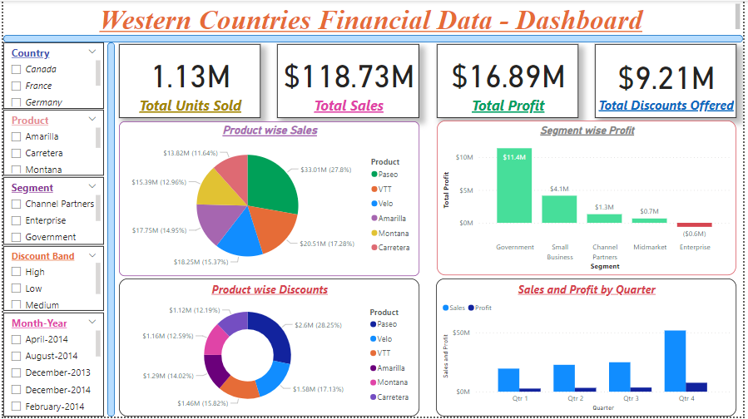
Interactive Dashboard by using visualization tools

Slide 23
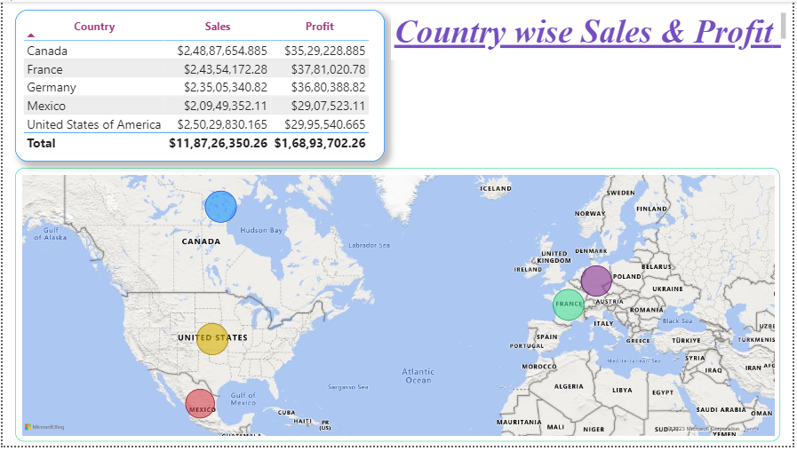
Interactive Dashboard by using visualization tools

Slide 24
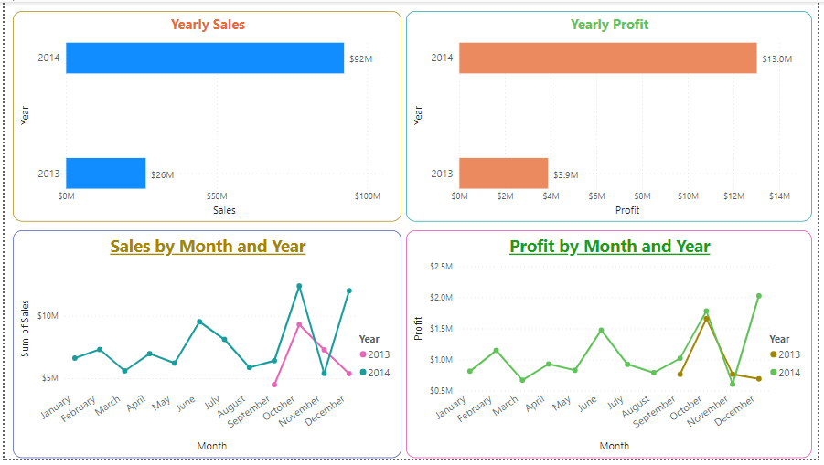
Interactive Dashboard by using visualization tools

Slide 25
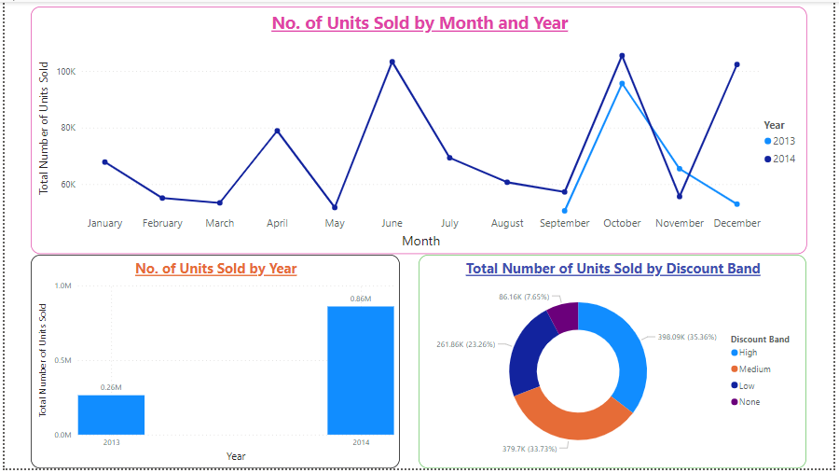
Interactive Dashboard by using visualization tools

Slide 26
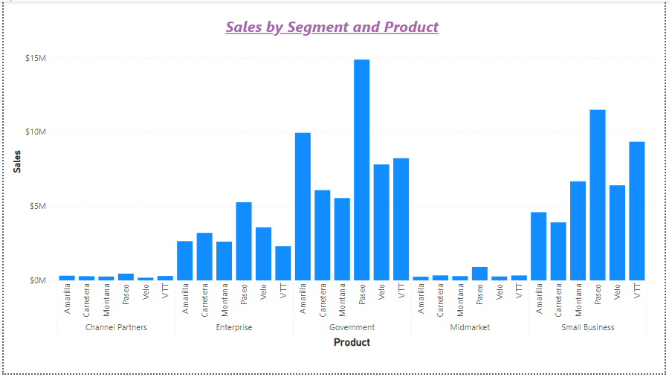
Interactive Dashboard by using visualization tools

Slide 27
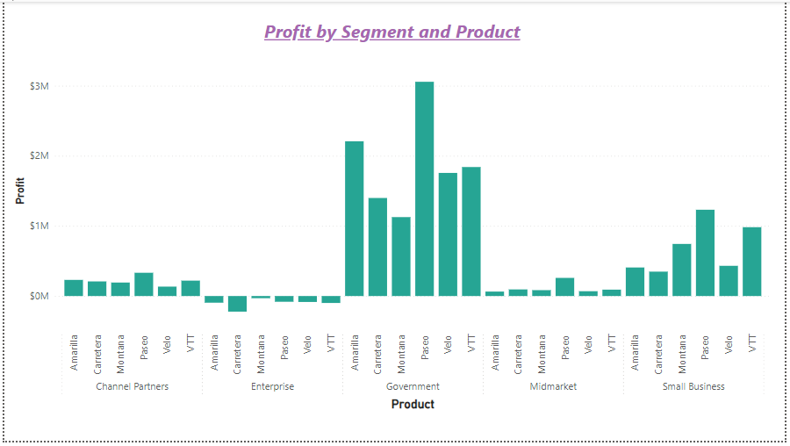
Interactive Dashboard by using visualization tools

Slide 28
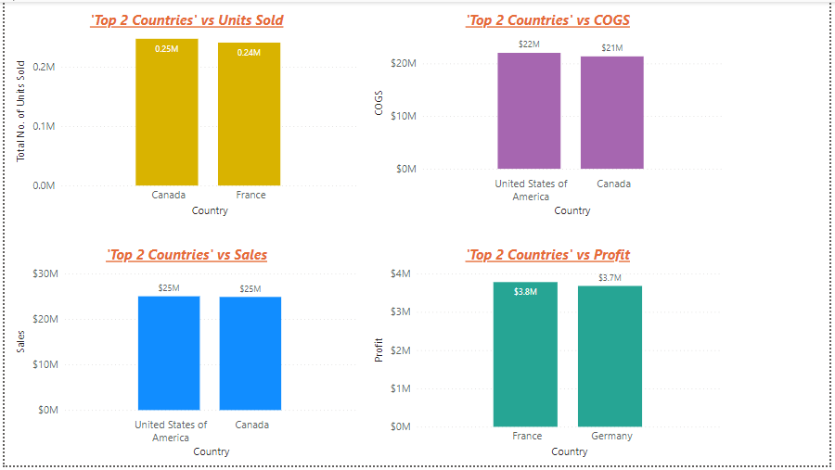
Interactive Dashboard by using visualization tools

Slide 29
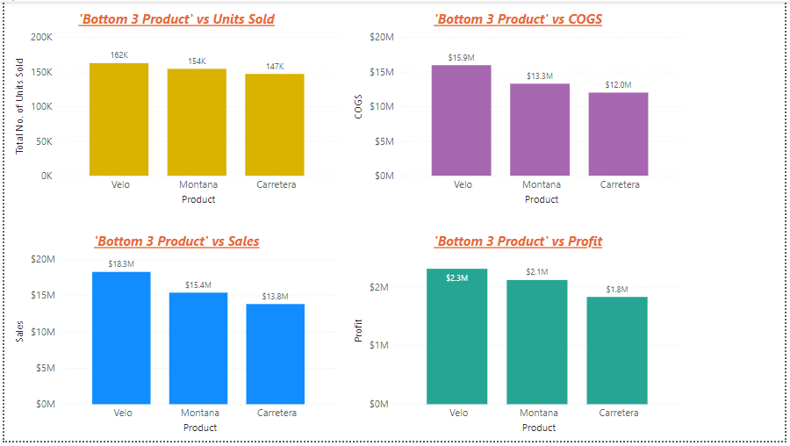
Interactive Dashboard by using visualization tools

Slide 30
Conclusion and Inferences
Tota number of units sold during the period ‘September 2014 to December 2014’ is more than the ‘September 2013 to December 2013’. It can be seen that in the said period there is an increase observed for September (about 13%), October (about 10%) & Decemebr (about 93%) moth of 2014 with respect to 2013 where as in Novemeber month (about -15%) it decresase. Similar tend is followed for the profit and sales also (percentge change may be differ).
Maximum number of units sold corresponding to Discount band having ‘High’ and it has the contribution about 36%, where as maximum profit (about 37% of total profit) made corresponding to ‘Low’ Discount band.
Every segment has made a profit except the ‘Enterprise’. Enterprise has made loss(negative profit) for every product. Segment ‘Government’ has made the maximum profit and maximum sales.
Quarter 4 has the maximum sales and profit.
From country wise profit analysis, it can be seen that “France” has the maximum profit of about 23% of total profit follwoed by the Germany about 22%, Canada about 21%, USA 18% & Mexico 17%.
Bottom 3 product for Units Sold, COGS, Sales, and Profit are Velo, Montana & Carretera.
Maximum number of transaction done in June, October, and December.

Slide 31
Endnotes
Reference Links:-
Excel File
2. Power BI File

